Slide 1

Using Github's Copilot to Write R Code Faster
Helena McMonagle
Graduate Student Symposium
November 17, 2023
Notes:
"Why Is It Called A Roadrunner?" by goingslo is licensed under CC BY 2.0.

Slide 2
Once upon a time…

Slide 3
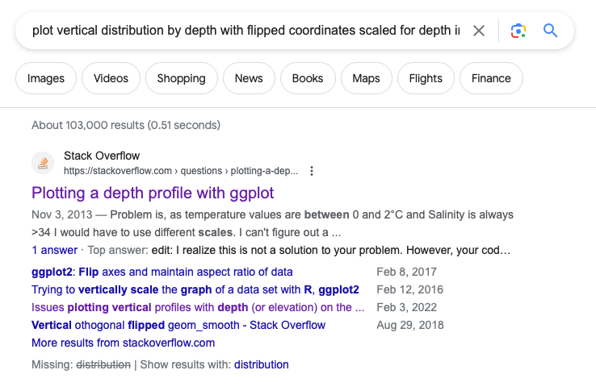

Slide 4
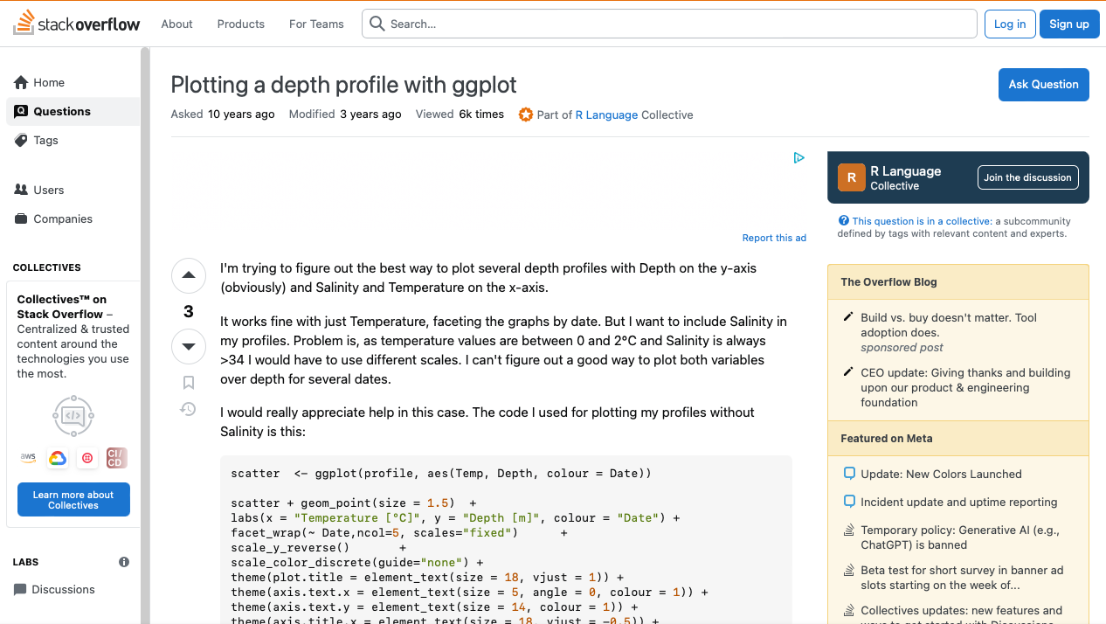

Slide 5
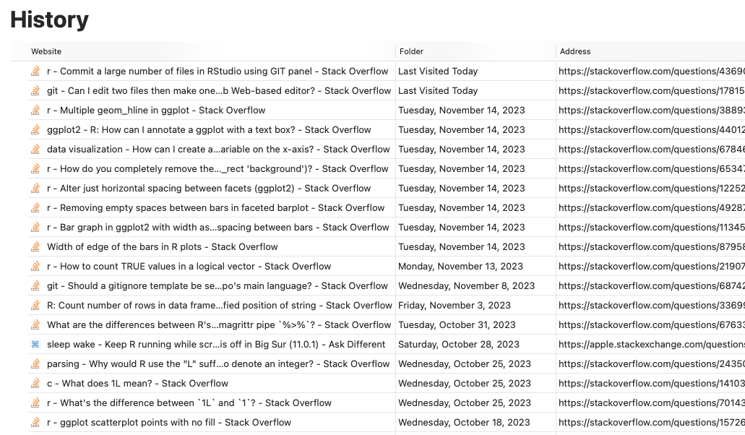

Slide 6
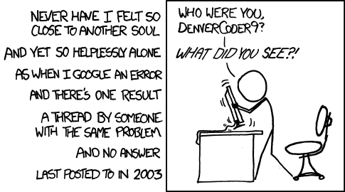
Notes:
xkcd.com

Slide 7

Enter Copilot…

Slide 8
Ok, so what is Copilot?

Slide 9
Ok, so what is Copilot?
Generative artificial intelligence
AI model that can create new content, like images, music, text or code
Uses neural networks, deep learning, and other techniques to find patterns and create new outcomes based on those patterns
Integrated with R and R Studio, as of last month

Slide 10
Ok, so what is Copilot?
Generative artificial intelligence
AI model that uses neural networks, deep learning, and other techniques to find patterns and create new content based on those patterns
Integrated with R and R Studio, as of last month

Slide 11
Ok, so what is Copilot?
Generative artificial intelligence
AI model that uses neural networks, deep learning, and other techniques to find patterns and create new content based on those patterns
“Pair programmer” that provides code suggestions in real-time
Integrated with R and R Studio, as of last month

Slide 12
Ok, so what is Copilot?
Generative artificial intelligence
AI model that uses neural networks, deep learning, and other techniques to find patterns and create new content based on those patterns
“Pair programmer” that provides code suggestions in real-time
Integrated with R and R Studio, as of about a month ago

Slide 13
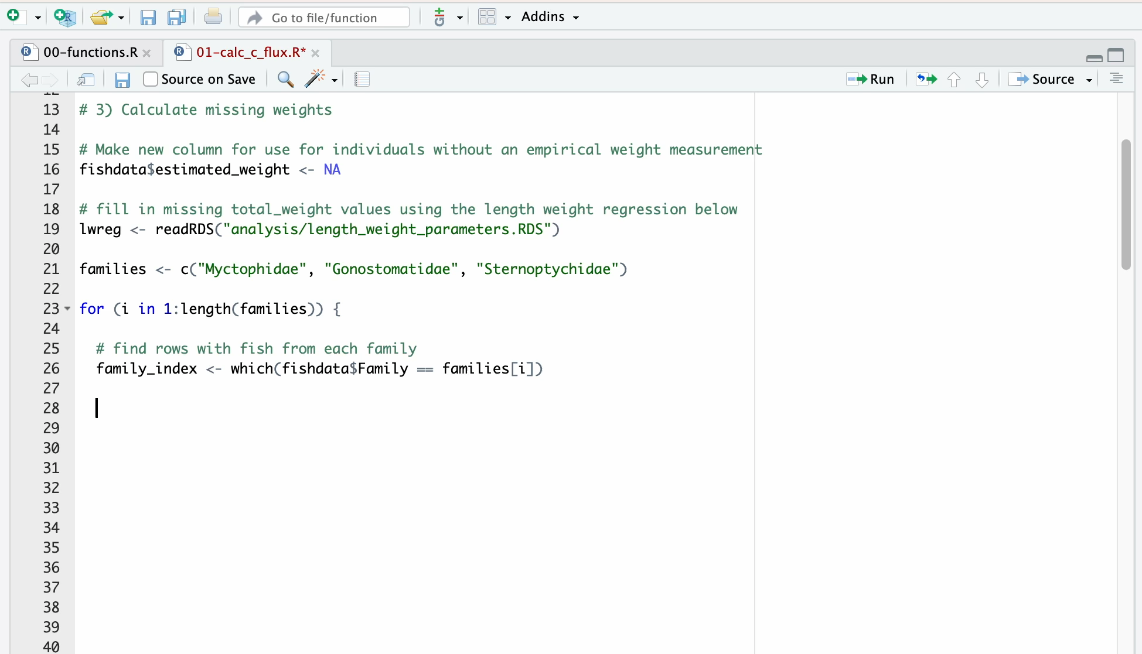

Slide 14
How do I get this new-fangled thing?

Slide 15
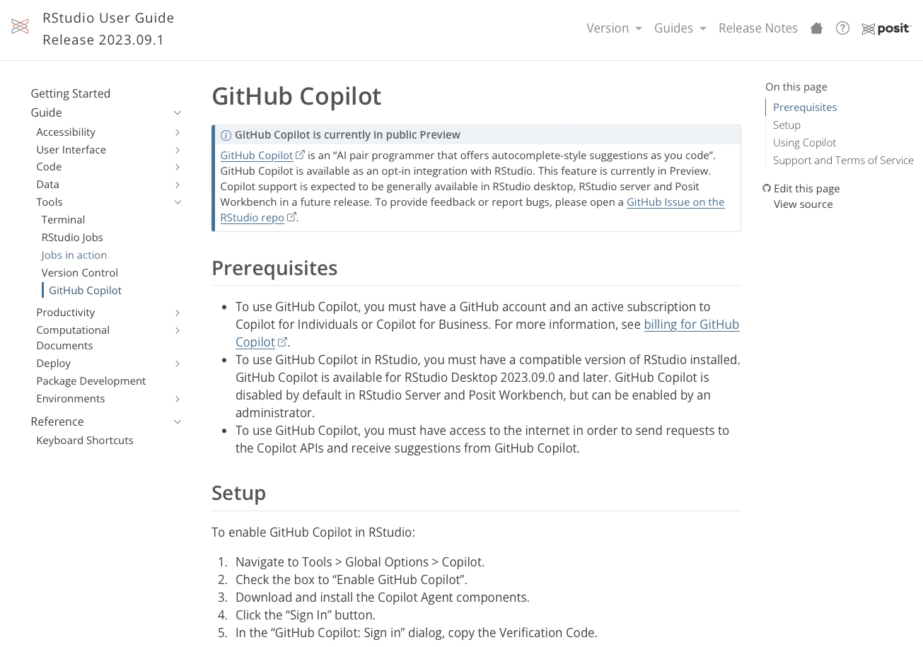

Slide 16
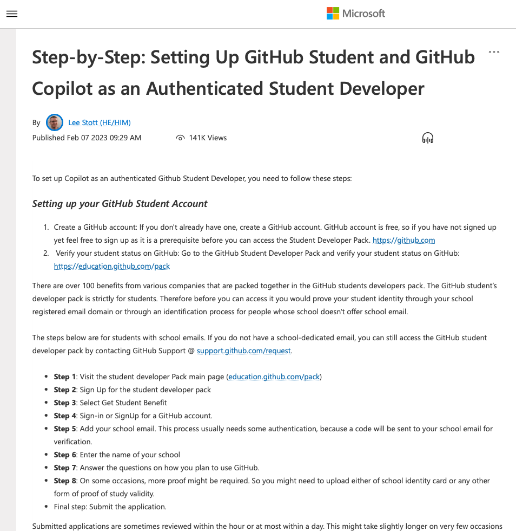

Slide 17
But what does it do? How does it work?
Uses patterns from earlier and later in your code to make suggestions
Annotations, code, and other context will be used as a “prompt”
Suggests “ghost code” after you pause, which you can accept or not

Slide 18
But what does it do? How does it work?
Uses patterns from earlier and later in your code to make suggestions
Annotations, code, and other context will be used as a “prompt”
Suggests “ghost code” after you pause, which you can accept or not

Slide 19
But what does it do? How does it work?
Uses patterns from earlier and later in your code to make suggestions
Annotations, code, and other context will be used as a “prompt”
Suggests “ghost code” after you pause, which you can accept or not

Slide 20
But what does it do? How does it work?
Uses patterns from earlier and later in your code to make suggestions
Annotations, code, and other context will be used as a “prompt”
Suggests “ghost code” after you pause, which you can accept or not

Slide 21
Ways I’ve used Copilot
Writing a loop
Data visualization
Data cleaning

Slide 22
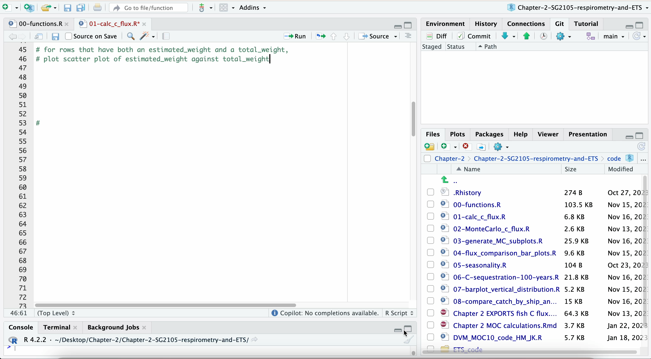

Slide 23
Pros and cons of using Copilot and similar tools
Pros:
It can speed up coding tasks, especially simple ones
It’s free
It has sometimes taught me better ways of doing things
Cons:
Probably not a good choice for your top secret projects
It makes mistakes
It won’t solve all your life problems, or even all your coding problems
Attribution might be tricky

Slide 24
Pros and cons of using Copilot and similar tools
Pros:
It can speed up coding tasks, especially simple ones
It’s free
It has sometimes taught me better ways of doing things
Cons:
Probably not a good choice for your top secret projects
It makes mistakes
It won’t solve all your life problems, or even all your coding problems
Attribution might be tricky

Slide 25
Pros and cons of using Copilot and similar tools
Pros:
It can speed up coding tasks, especially simple ones
It has sometimes taught me better ways of doing things
It’s free
Cons:
Probably not a good choice for your top secret projects
It makes mistakes
It won’t solve all your life problems, or even all your coding problems
Attribution might be tricky

Slide 26
Pros and cons of using Copilot and similar tools
Pros:
It can speed up coding tasks, especially simple ones
It has sometimes taught me better ways of doing things
It’s free
Cons:
Probably not a good choice for your top secret projects
It makes mistakes
It won’t solve all your life problems, or even all your coding problems
Attribution might be tricky

Slide 27
Pros and cons of using Copilot and similar tools
Pros:
It can speed up coding tasks, especially simple ones
It has sometimes taught me better ways of doing things
It’s free
Cons:
Probably not a good choice for your top secret projects
It makes mistakes
It won’t solve all your life problems, or even all your coding problems
Attribution might be tricky

Slide 28
Pros and cons of using Copilot and similar tools
Pros:
It can speed up coding tasks, especially simple ones
It has sometimes taught me better ways of doing things
It’s free
Cons:
Probably not a good choice for your top secret projects
It makes mistakes
It won’t solve all your life problems, or even all your coding problems
Attribution might be tricky

Slide 29
Pros and cons of using Copilot and similar tools
Pros:
It can speed up coding tasks, especially simple ones
It has sometimes taught me better ways of doing things
It’s free
Cons:
Probably not a good choice for your top secret projects
It makes mistakes
It won’t solve all your life problems, or even all your coding problems
Attribution might be tricky

Slide 30
Pros and cons of using Copilot and similar tools
Pros:
It can speed up coding tasks, especially simple ones
It has sometimes taught me better ways of doing things
It’s free
Cons:
Probably not a good choice for your top secret projects
It makes mistakes
It won’t solve all your life problems, or even all your coding problems
Attribution could be tricky

Slide 31
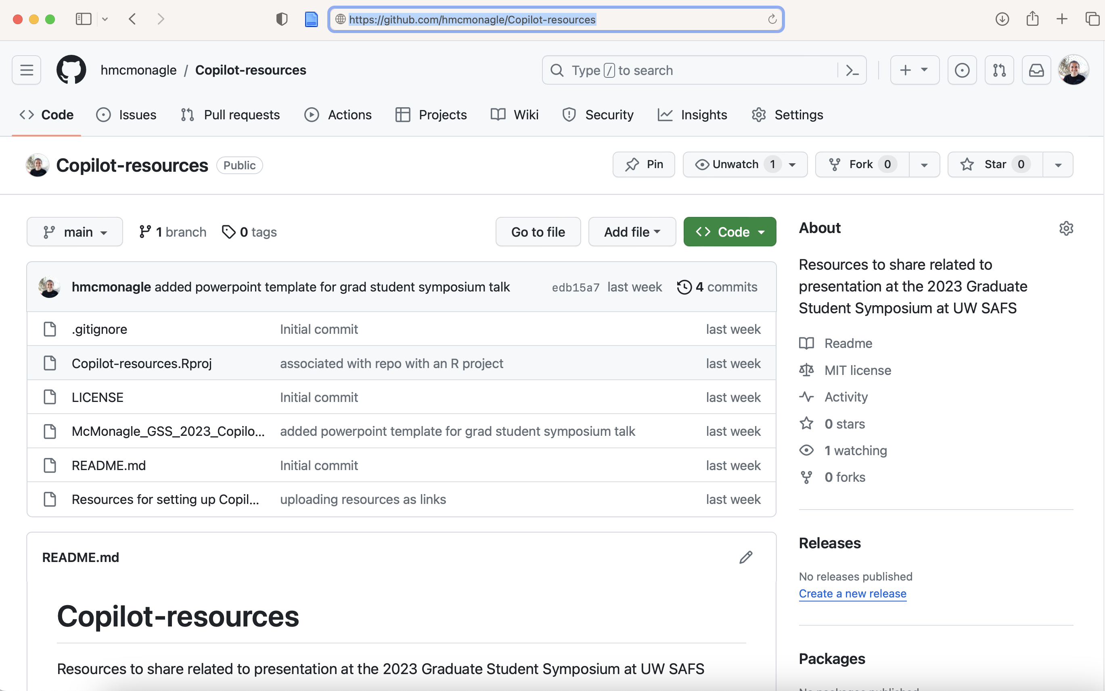
Where can I find these links?
github.com/hmcmonagle/Copilot-resources

Slide 32
Questions? Ethical concerns? Ideas?

